Slide 1

Kickstarter Crowdfunding Project
Date : 6th April 2024
Presenter : Group 5
Chaitanyachidambar Kulkarni
Shital Kumbhar
Poornima Gopinathan
Veena Kalserkar

Slide 2
What it is?
A crowdfunding platform that helps generate funding for creative projects.
Product Creators: The creators post a Kickstarter campaign to gauge how much a new product will succeed before investing in manufacturing.
Backers: Pledge to purchase a product before it's on the market thereby support the creation of new creative products
Main Players
Funding
Product Creators: The creators set a funding goal and the duration to achieve it.
Backers: Backers are charged only if the creator meets his/her funding goal and the duration.
It's a win win for both, the Creator and the backer.
If the campaign is successful the creator knows how much of the product needs to be manufactured and ordered.
If the campaign is not funded then the backers do not lose anything.
Outcome

Slide 3
Key Cards
3,65,892
140K
4 B
38.3%
31.90
Total no. projects
No of backers/Success
Amount Raised
% of successful project
Average no of days

Slide 4
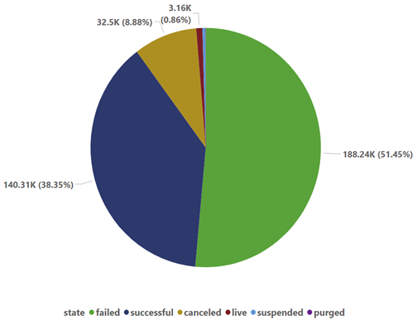
Overview
The project outcome report reveals a comprehensive overview of projects across different states.
188,239 projects marked as failed and 140,313 projects recorded as successful, there's a notable disparity in outcomes.
178 projects have been purged, while 3,163 projects are currently live and actively progressing.
The suspension of 1,501 projects raises concerns about their viability and requires further examination.
Cancellation of 32,498 projects underscores challenges in project management and resource allocation.
In total, there are 365,892 projects captured across all states, reflecting a diverse landscape of project outcomes and highlighting the importance of effective project monitoring and evaluation.

Slide 5
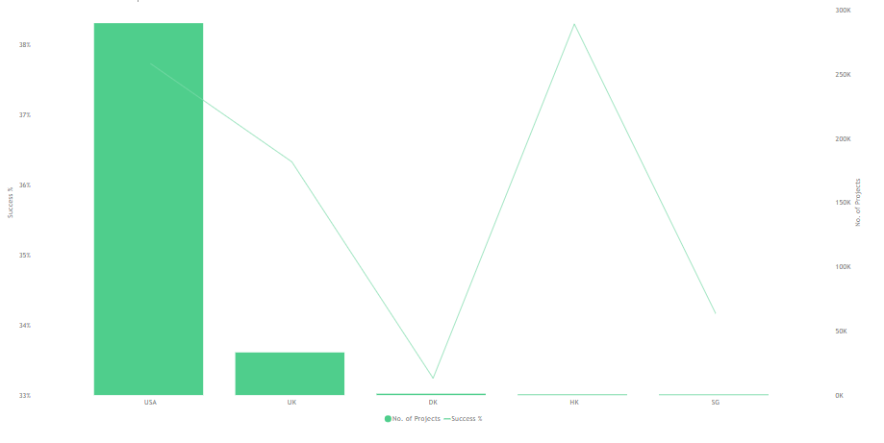
Key Analysis
The top 5 countries in which to source the projects
USA,
the UK
Denmark
Hong Kong
singapore

Slide 6
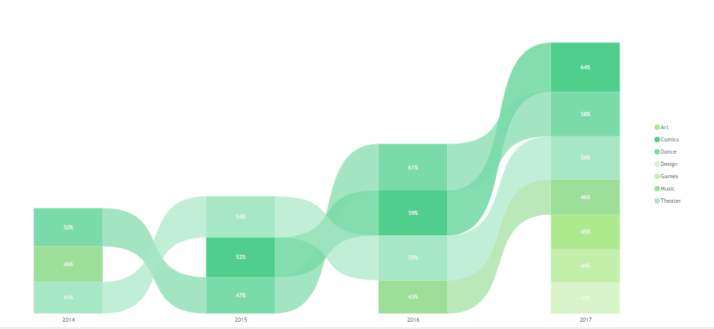
Key Analysis
Top investment categories to be considered based on their avg. success rate & avg- goal amount
Comics: success rate has been increasing over the past 3 years;
Dance: has the highest avg, success rate of all categories with lowest avg. goal amount;Theater; Music;

Slide 7
Key Analysis
In the year 2009, there were only 1.31K projects, which have increased year on year.
There was a significant increase observed in 2014 and 2015, with peaks of 59.16K and 58.1K projects, respectively.
In the subsequent years, there was a slight decline to 46.16K projects, but the number of projects remained consistently high, staying above 37K.
By 2019, there was a drastic drop to only 1.52K projects.
Initial Struggles (2009): The journey began with a low success rate of only 0.41%, highlighting initial challenges and learning curves.
Rapid Growth (2014): Achieved a peak success rate of 13.73%, showcasing effective strategies and improved execution.
Decline in Success (2019): Faced a steep decline to just 0.03%, necessitating an analysis of underlying issues and challenges.

Slide 8

Conclusion
Multiple outcomes for a project can be observed, viz., Successful, Failed, Live, Purged, Suspended and Cancelled.
It can be observed that the success of a project is low in comparison to failure, suspension and cancellation put together, which is concerning for a business. The average success rate for projects is 38.3% and only categories above this rate should be considered to maximize the possibility of success.
Among the many reasons for suspension, lack of trust and non-transparency in disclosing relevant information about the project or the creator, as well as presenting others' work as one's own, are significant factors.

Slide 9

Thank You

